Slide 1
H/S TOOLS MINI PROJECT
Presented by:
Mitali Jain (PA 07)
Piyush Pamnani (PA 34)
Ruchin Shroff (PA 35)

Slide 2
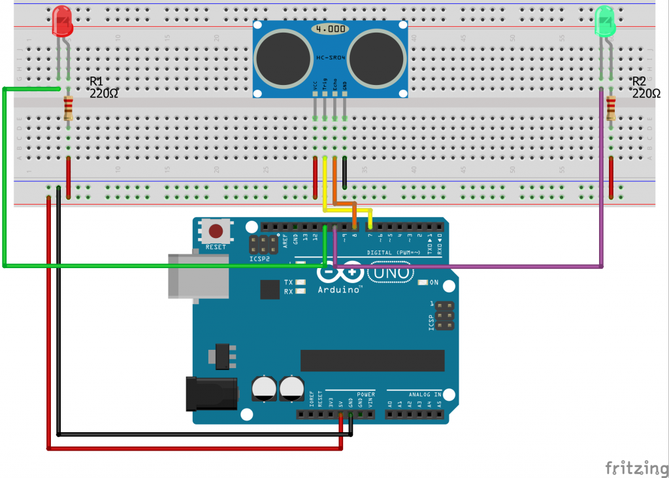
LED Machine Using Ultrasonic Sensor

Slide 3
INTRODUCTION
In this project we have designed a LED Machine using a ultrasonic sensor and a LED Pixel.
A fully implemented project can become an excellent interactive and playful exhibition installation or media facade of a modern architectural building or pavilion.
Actually to participate in the creation of an optical design that reflects the silhouette and gestures of people passing by right on the LED Matrix wall, controlled by proximity sensors.

Slide 4
COMPONENTS
Sr. No. | COMPONENTS | QUANTITY
1. | Arduino UNO | 1
2. | Ultrasonic Sensor | 1
3. | Connecting Wires | -
4. | IC MAX7219 | 1
5. | Active Variable Resistor | 1
6. | LED Matrix | 1

Slide 5
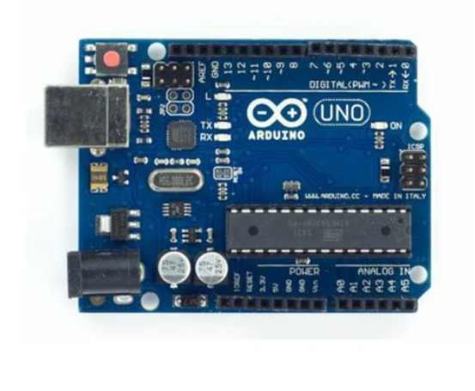
COMPONENTS DESCRIPTION
Arduino UNO:
Arduino is an open-source electronics platform based on easy-to-use hardware and software.
Arduino boards can read inputs light on a sensor, a finger on a button, or a message and turn it into an output activating a motor, turning on an LED, publishing something online.

Slide 6
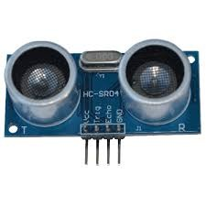
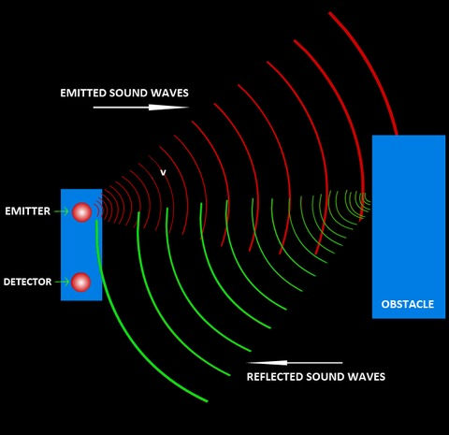
Ultrasonic Sensors:
An ultrasonic sensor is an electronic device that measures the distance of a target object by emitting ultrasonic sound waves, and converts the reflected sound into an electrical signal. Ultrasonic waves travel faster than the speed of audible sound (i.e. the sound that humans can hear).

Slide 7
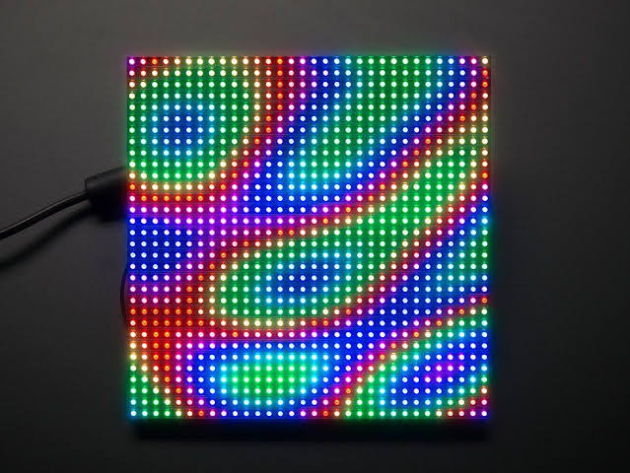
LED Pixel
Led matrix is a dot matrix of large display, low resolution value and is useful for both industrial or commercial displays as well as for hobbyist human interface machines. In contains a 2-D diode matrix which have the cathode joined in rows and anode in columns.

Slide 8
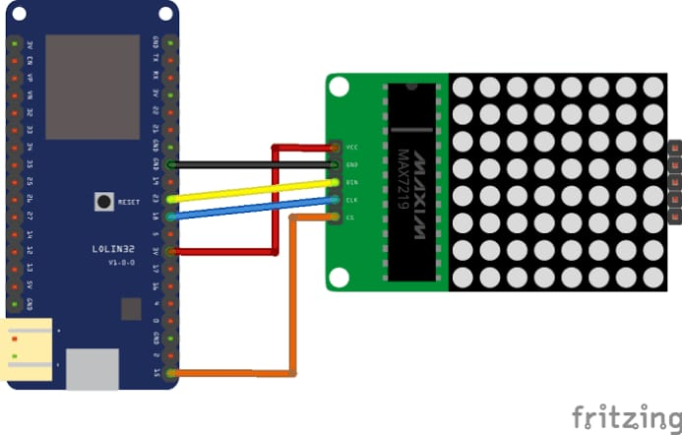
IC MAX7219
MAX7219 is a common-cathode display driver IC with serial inputs and output pins. It has an adjustable current capability which can be set using only one external resistor.
In addition to that, it has a four-wire serial interface that can be easily connected to all microprocessors. It can drive 64 individual LEDs connected at its output pins using only 4 wires by using Arduino.

Slide 9
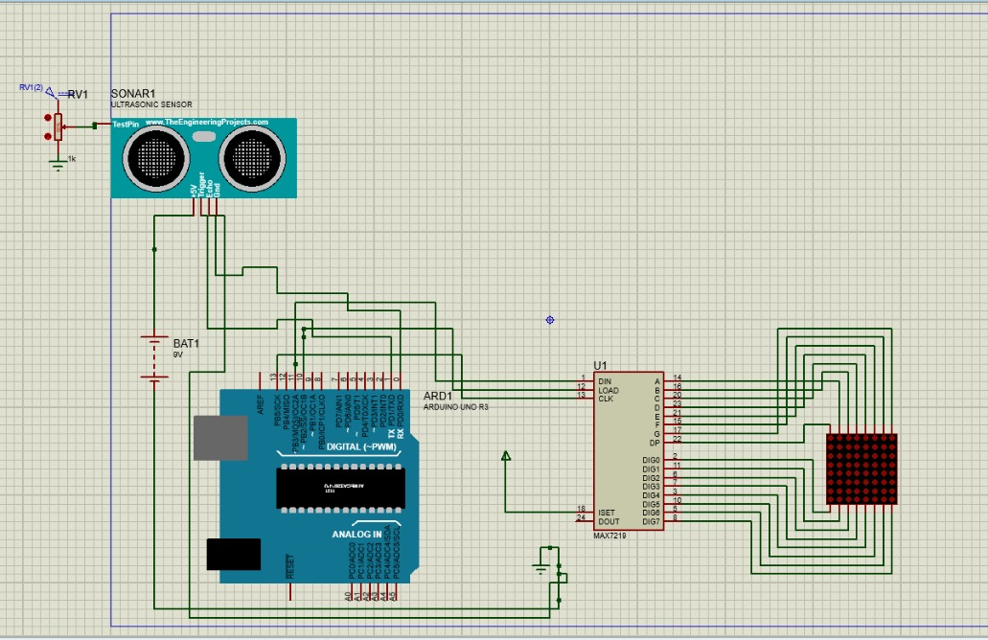
CIRCUIT DIAGRAM

Slide 10
WORKING PRINCIPLE
The components from the Arduino IOT Bundle are connected with one rangefinder sensor. As a result, the system starts working in one direction and sequentially lit up and extinguished the required row of diodes, depending on the distance to the object in front of the rangefinder.
The next stage of modernization is to make the light move along the (X; Y) axis.
Connect 4 proximity sensors as efficiently as possible. In the end, line them up next to each other and do this in a box cover so that they all give the same distance to the far border.
The prototype works according to the principle:
It is determined in front of which of the sensors the object is located. This is how the column of diodes is sampled along the X axis.
Having chosen the sensor with which to work, the distance to it is read and the illuminating diodes are searched along the Y axis.
So when any object moves in front of the ultrasonic sensors that are placed in the box, the light on the RGB LED lit up , according to the movement of the object.

Slide 11
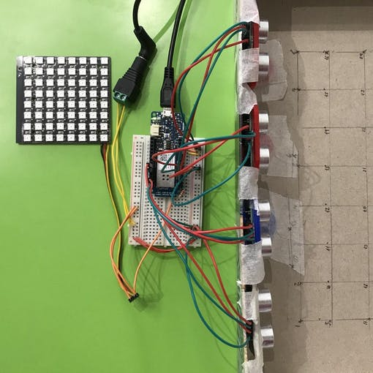
The Arduino Uno is a microcontroller board based on the ATmega328. It has 20 digital input/output pins (of which 6 can be used as PWM outputs and 6 can be used as analog inputs), a 16 MHz resonator, a USB connection, a power jack, an in-circuit system programming (ICSP) header, and a reset button.
Ultrasonic sensors emit short, high-frequency sound pulses at regular intervals. If they strike an object, then they are reflected back as echo signals to the sensor, which itself computes the distance to the target based on the time-span between emitting the signal and receiving the echo.

Slide 12
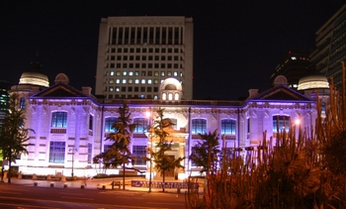
Bank of Korea
APPLICATIONS
Korea’s central bank was created in 1950, to set price stability. The classically designed building has been given a modern face lift with this purple LED lighting.

Slide 13
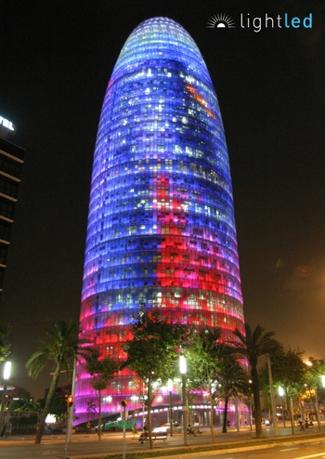
Agbar Tower
Light-emitting diodes, or LEDs, are reinventing the look and feel of skylines, bridges, facades and other architectural surfaces around the globe. The light bulb is being unscrewed by energy-efficient LEDs that are both environmentally friendly and cost-effective. The $10.2 billion industry is growing to provide new design options for architects and planners. Left: This Barcelona office, designed by the French architect Jean Nouvel, brings color 142 meters into city skyline. A total of 4,500 L3 RGB lights were installed to illuminate the 32 floors of offices in the Agbar tower. The lighting system, which contains 4,500 L3 RGB lights, is controlled from a single computer.

Slide 14
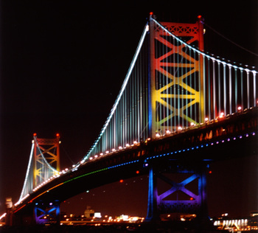
Ben Franklin Bridge
This bridge in Philadelphia was given a dramatic overhaul when lights were added to the anchorages and towers. Old and rusting bridges can be given new life with a rainbow of colors. With a declining cost in maintenance, LED lights can now be used to decorate bridges and other structures that are subject to rusting.

Slide 15
REFERENCES
https://www.kth.se/en/studies/master/architectural-lighting-design/description-1.7255
https://en.wikipedia.org/wiki/Architectural_lighting_design
www.google.com
https://www.electronicwings.com
www.cdsys.co.uk
www.circuitsgallery.com
www.circuitdigest.com
https://www.researchgate.net/
https://create.arduino.cc/projecthub/Mukhin/led-architectural-machin-bb67ba
https://www.hackster.io/Mukhin/led-architectural-machin-bb67ba
http://ocs.editorial.upv.es/index.php/LC2015/LC2015/paper/viewFile/679/1287

Slide 16
CONCLUSION:
A fully implemented project can become an excellent interactive and playful exhibition installation or media facade of a modern architectural building or pavilion.
The architectural way of this project reveals its potential when interacting with social environment, involving people by its conspicuous and creating the desire to take part in the interactive. Actually to participate in the creation of an optical design that reflects the silhouette and gestures of people passing by right on the LED Matrix wall, controlled by proximity sensors.
Architectural lighting design is a field of work or study that is concerned with the design of lighting systems within the built environment, both interior and exterior.
Lighting design is based in both and the visual arts. The basic aim of lighting within the built environment is to enable occupants to see clearly and without discomfort.

Slide 17
THANK YOU
I would like to express my special thanks of gratitude to our Professor Ms. Ujjwala Rawandale, who gave us the golden opportunity to do this wonderful presentation on the topic: LED Machine using Ultrasonic Sensor. This also helped us in doing a lot of research which in turn added to our knowledge and skills.
We would also like to thank each other who added great outlook on information and cumulatively we completed our presentation.

